Slide 1
Jermyn Borough Council Meeting
5/21/2026

Slide 2
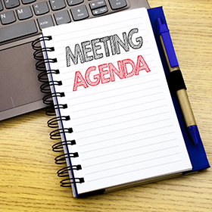
Meeting Agenda
MAY 21, 2026
CALL TO ORDER
PLEDGE OF ALLEGIANCE
ROLL CALL
PREVIOUS MEETING MINUTES
TREASURER'S REPORT/BILLS PAYABLE
CORRESPONDENCE
SECRETARY REPORT
PUBLIC COMMENT
PROFESSIONAL REPORTS
  MAYOR/POLICE/250 UPDATE
  SOLICITOR
  FIRE CHIEF
  TAX COLLECTOR
  KBA
  EMA
COMMITTEE REPORTS
  SAFETY
  FINANCE
  SHADE TREE
  RECREATION
  NORLACK
MS4 ORDINANCE
.GOV EMAILS
AGENDA FOR JUNE 10 TOWN HALL
STREET LIGHT AT MOON AND MIKRIDGE
INTERSECTION OF WASHINGTON/EYNON JERMYN ROAD
CODE OFFICER
NEW BUSINESS
ADJOURNMENT

Slide 3
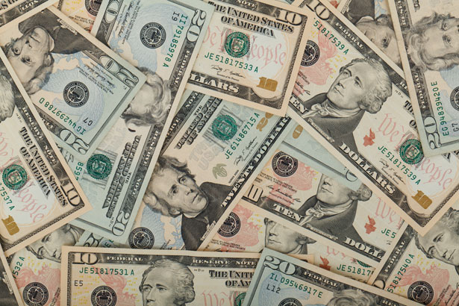
Treasurer’s report
5/21/2026
ASSETS
Checking/Savings
American Rescue Plan Fund 92,614.86
Capital Reserve - DPW 1,300.28
Capital Reserve - Police 5,244.82
Crime Watch Fund 222.69
General Fund - Community 222,212.58
General Fund - FNB 3,430.86
Holiday Lights Fund 400.59

Slide 4
Treasurer’s report
Investment - General Fund 1,188.00
Investment - Liquid Fuels 26,161.15
Investment - Paving Fund 1,200.25
Investment - Recycling 130.53
Investment - Refuse 187.20
Liquid Fuels - FNB 42,915.56
Petty Cash 194.00
Recreations Fund 20,588.53
Recycling - Community 10,141.26
Refuse Checking - FNB 259,645.93
Total Checking/Savings 687,779.09

Slide 5
Treasurer’s report
200000 · Accounts Payable 8,009.06
Long Term Debt 415,300.00

Slide 6
MS4 Minute
https://www.youtube.com/watch?v=sBhzpZD8i8s

Slide 7


